Slide 1
RNN
Text Sequence Prediction
Part B
Yadanar Aung
2214621
DAAA/FT/2B/07
ST1504 DELE

Slide 2
Table of contents
01.
02.
03.
Data Understanding
Data Preprocessing
Modelling
Exploratory Data Analysis
Input-Output Pairs
RNN, LSTM, GRU, Bidirectional LSTM
04.
05.
Model Improvement
Model Evaluation
Regularizers
Embedding Dimensionality
Perplexity
Bleu Score

Slide 3
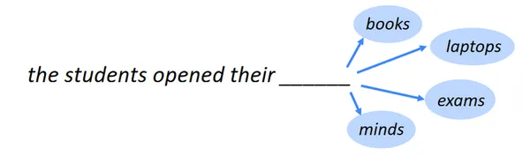
Background Understanding
01
Task: Build a next-word predictor given a sequence of words
In other words, Text Generation:
AI system to generate coherent & meaningful text that resembles natural human communication
AI model learns patterns, grammar & contextual information during training

Slide 4
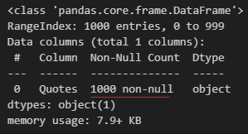
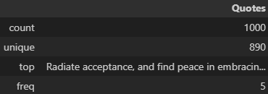

Data Understanding
01
Train_csv Dataset:
Total of 1000 quotes
No missing values
Statistical Description:
890 Unique Quotes
110 Repeated Quotes
Drop Duplicates:
To prevent influence & biases during training
First 5 Quotes:

Slide 5


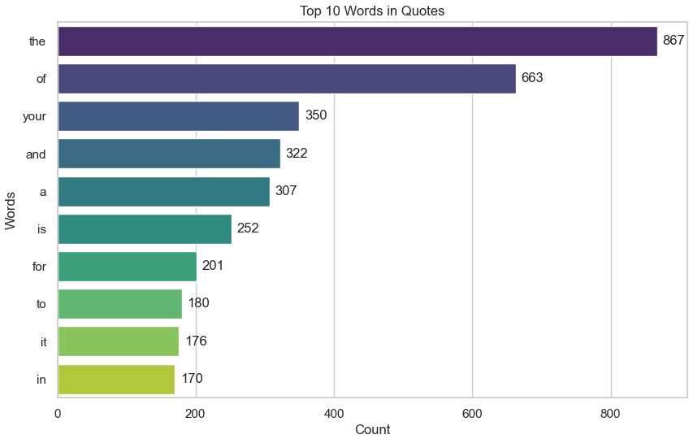
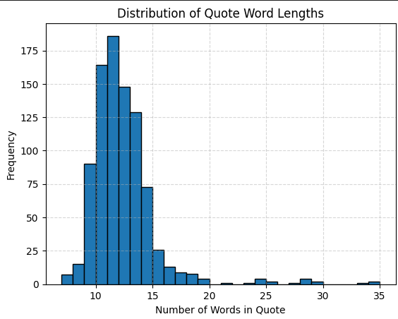
Exploratory Data Analysis
01
Word Length of Quotes:
Common: 11 to 13 words
Count of Word Occurrence in Quotes:
Common Words are a type of determiner & would go before a noun

Slide 6
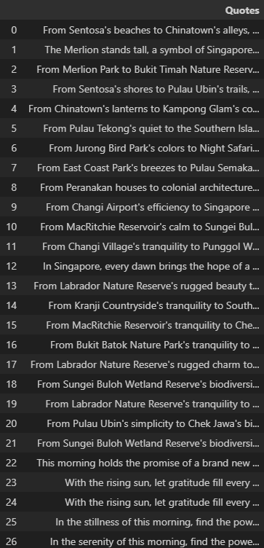
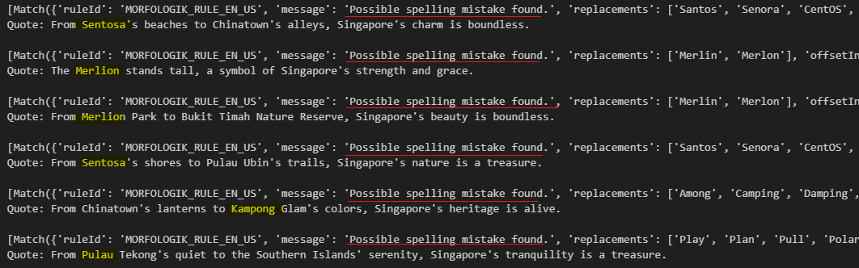
Exploratory Data Analysis
01
Language Check for Grammar & Spelling
Language-tool-python package
Errors triggered due to words not being english.
Instead, words were Malay Singaporean Words

Slide 7
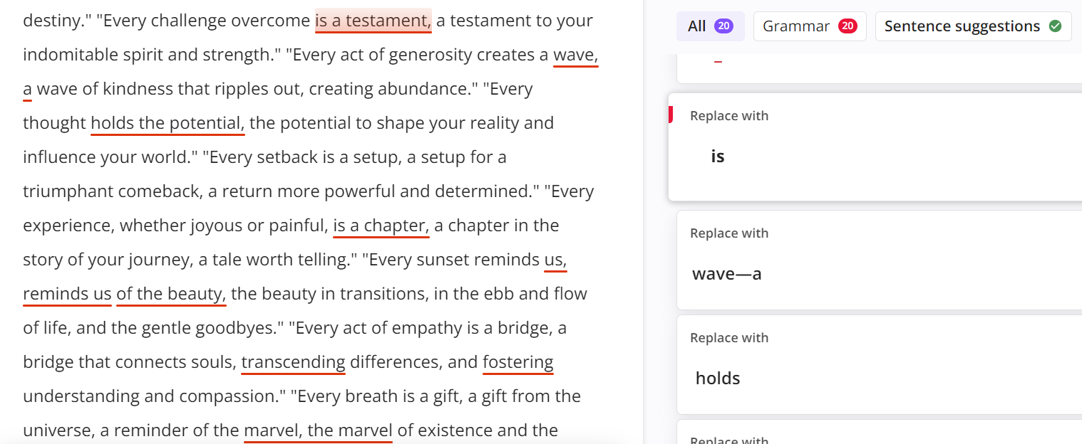
Exploratory Data Analysis
01
Language Check for Grammar & Spelling
2. QuillBot: Online Tool to Perform Language Check
Pattern of repeated patterns in quotes

Slide 8
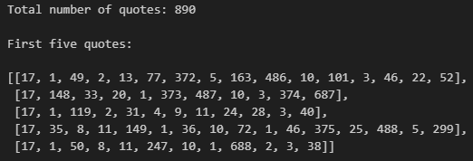
Data Pre-Processing
02
No language changes
Model to learn these pattern & contextual information
Tokenization: Convert Text to Integers using fit_on_texts
Build Input Sequence Data using texts_to_sequence
Notes:
https://quillbot.com/grammar-check

Slide 9
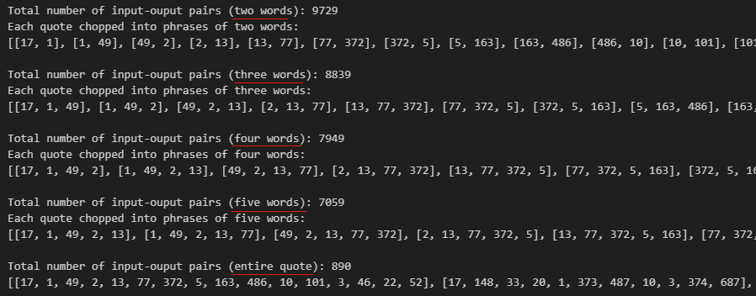
Data Pre-Processing
02
4. Generate Input-Output Pairs: Fit more training data to the model
Help model to predict next word using n words
Pad with zeros to have same length to maintain fixed input size
Notes:
https://quillbot.com/grammar-check

Slide 10
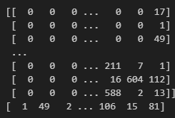

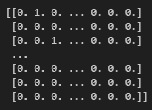

Data Pre-Processing
02
5. Split into X & y dataset:
No train or test dataset as we are not training model to give a fixed output
6. One-Hot Encoding:
Treat as classification problem with 1199 classes
Notes:
https://quillbot.com/grammar-check

Slide 11
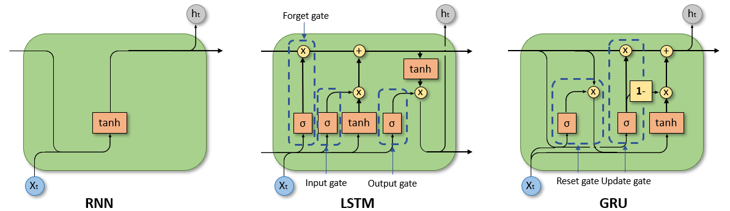
Modelling
03
4 Candidate Models:
Simple RNN
Simple LSTM
Simple GRU
Bi-directional LSTM

Slide 12
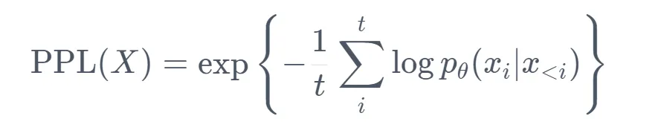
Modelling
03
Evaluation Methodology:
Perplexity:
Aim: Evaluate how meaningful generated sequence of words are
Measures how well a probability model can predict a sample
The lower the perplexity, the better the training is
Model is more certain of its sequential predictions
Exponentiated of mean of log likelihood of all the words in an input sequence
Notes:
Evaluation Methodology to measure quality of generated sequence
Perplexity in other words means to be surprised.

Slide 13
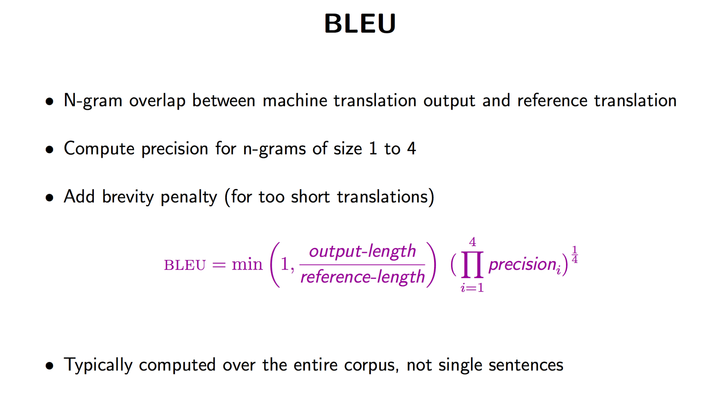
Modelling
03
Evaluation Methodology:
2. BLEU Score:
Aim: Evaluate how creative the generated sequence of words are
Measures the number of n-grams in generated text that match the n-grams in input text, in other words the similarity
Varies from 0 to 1:
0: No n-gram overlap
1: Total n-gram overlap
Brevity Penalty
Lower BLEU Score:
More Varied & Creative Output
Trade-Off:
Sensibility of generated text

Slide 14
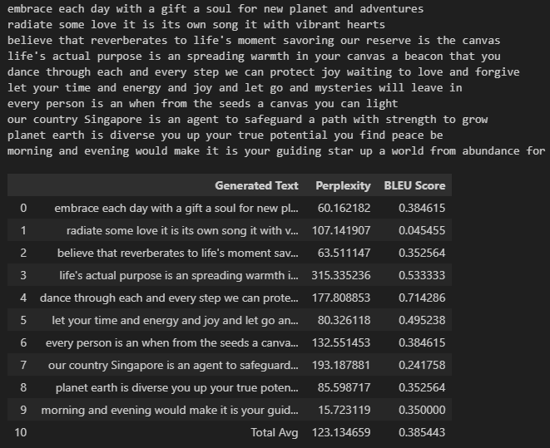
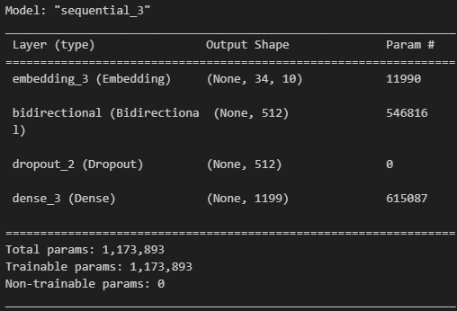
Model Selection
03
By predicting using the seed_text & comparing the perplexity & BLEU Scores
Selected Model: Bidirectional LSTM
Bidirectional LSTM Model Architecture

Slide 15
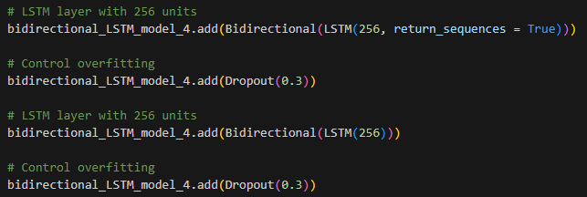
Model Improvement
04
Added one more Bi-Directional LSTM Layer
To increase model’s capacity to learn more complex patterns & representations
Increased dimensionality word embeddings from 10 to 64.
Larger capacity to learn more expressive representations & reduce information loss
Add Kernel Regularization
Prevent overfitting & promote more generalizable representations
L1 vs L2 Regularization

Slide 16
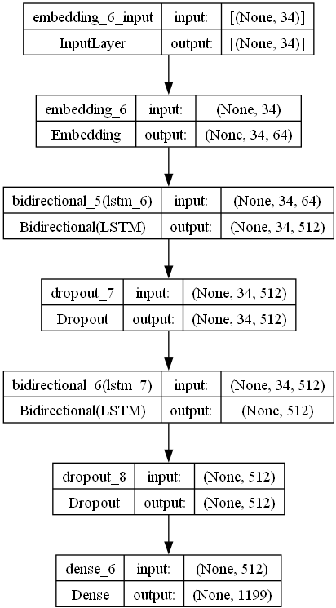
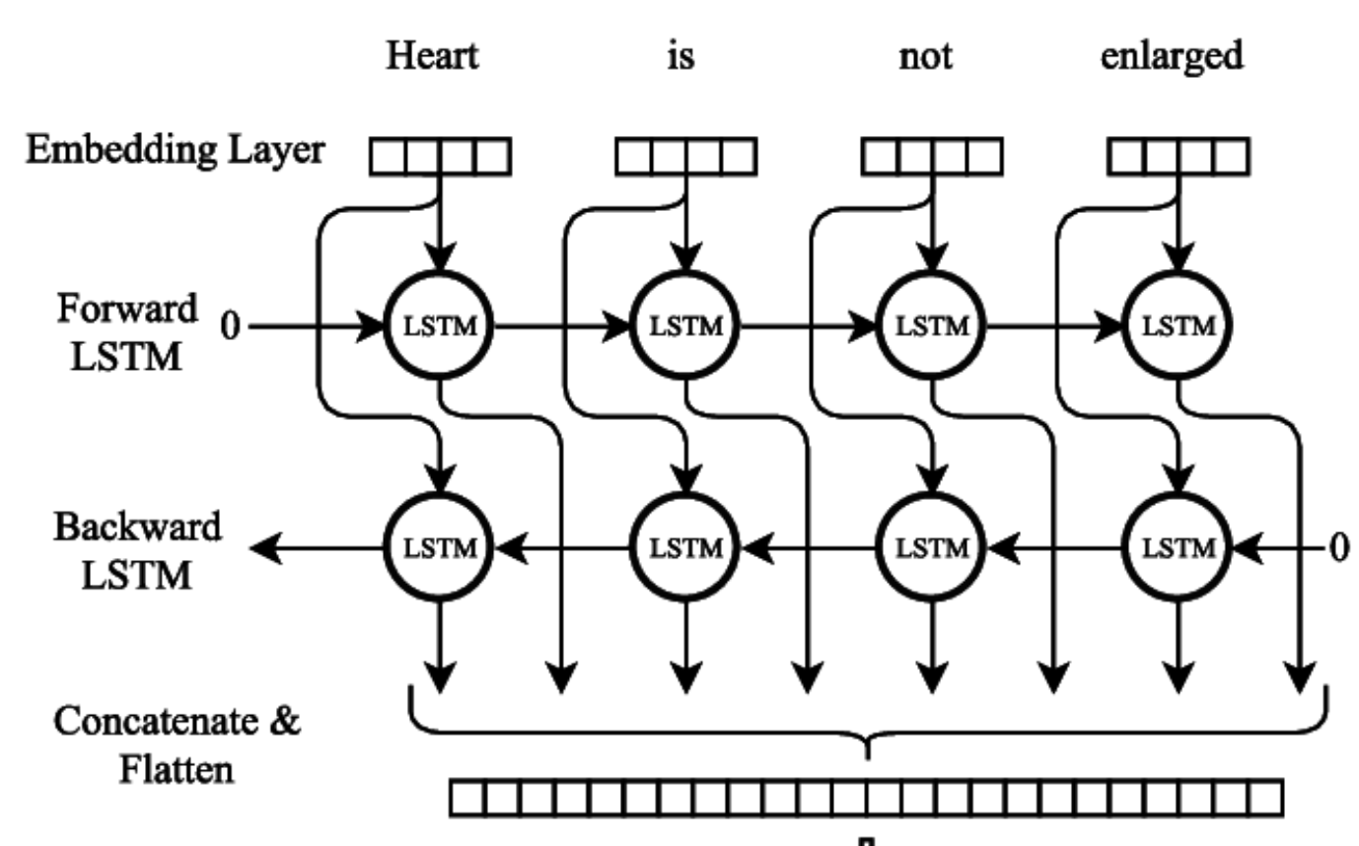
Final Model
05
Bi-Directional LSTM Model with L2 Regularization

Slide 17
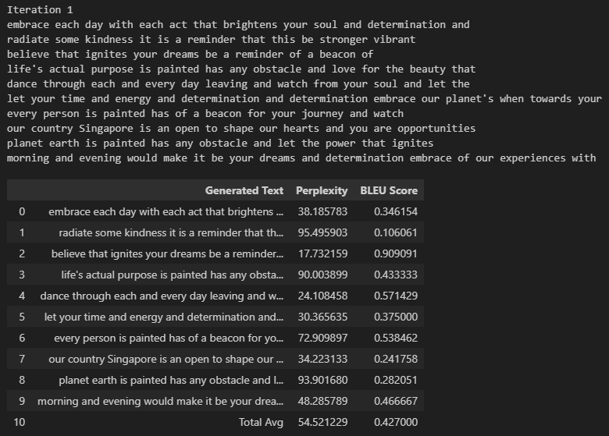
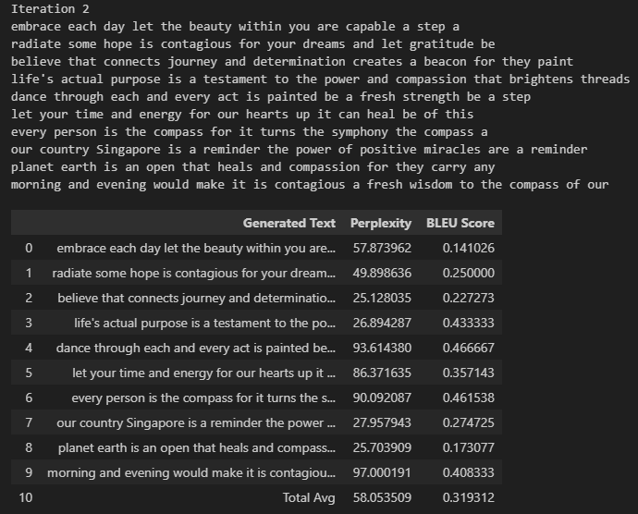
Model Evaluation
05

Slide 18
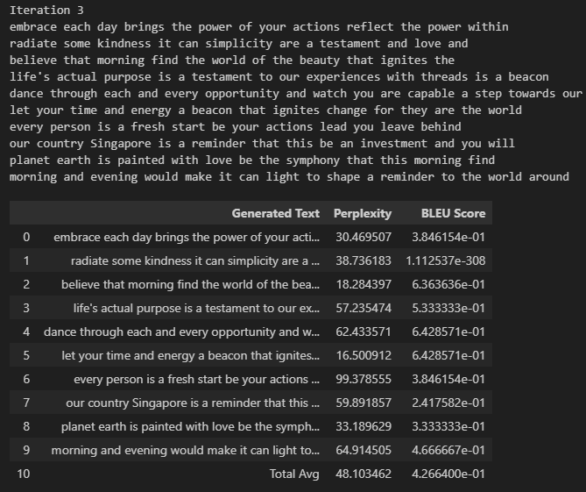
Model Evaluation
05

